Slide 1

Provision of HIV care by the GHESKIO Centers in the setting of complex humanitarian emergencies in Haiti
JEAN WILLIAM PAPE, MD
Howard and Carol Holtzmann Professor of Clinical Medicine,
Center for Global Health, Division of Infectious Diseases, Department of Medicine,
Weill Cornell Medical College, New York, New York, USA
Director,
Les Centres GHESKIO,
Port-au-Prince, Haïti.
@TwitterHandle
Share your thoughts on this presentation with #IAS2019

Slide 2
Outline: HIV Care by the GHESKIO Centers in setting of complex humanitarian emergencies in Haiti
Haiti: country profile
Measures to provide HIV care even when there are no crisis
GHESKIO Centers and its mission
The AIDS epidemic in Haiti 1982-2019
Humanitarian emergencies:
  Recurrent political crises and gang violence (1986-2019)
  Frequent major hurricanes
  2010 earthquake and cholera epidemic
Additional measures to provide HIV care at times of crisis
Summary and perspectives

Slide 3

Haiti: Country Profile
Poorest country in the Western hemisphere
  GNP unchanged in last 30 years
  80% college graduates live abroad.
Among most environmentally fragile countries
  Hurricanes, earthquakes (2010)…
  Epidemics: AIDS (1982), cholera (2010)
Political instability:
  22 governments since 1986 , + 2 UN occupations
  2018, 2019: huge protests against government corruption

Slide 4
Tract record to provide HIV care before and during crisis
                Long process
Institution must be credible
Experienced and dedicated staff
Excellent ethical standards
Must develop strong local roots
  With local institutions
  Community
Offer global health when needed to respond to the needs of the community
Need to stay outside politics
Additional measures needed at times of crisis

Slide 5
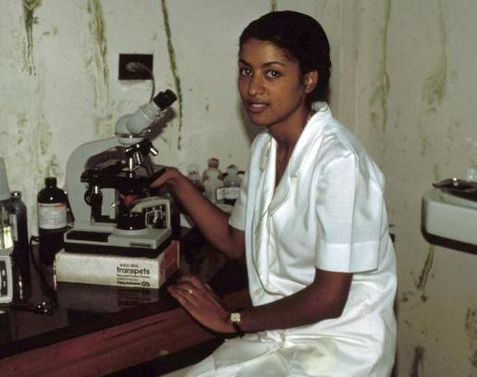
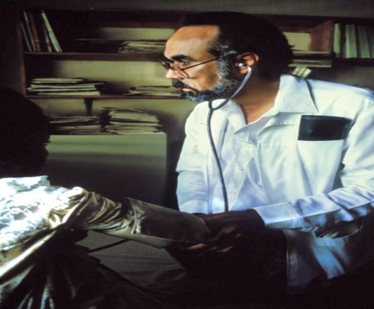
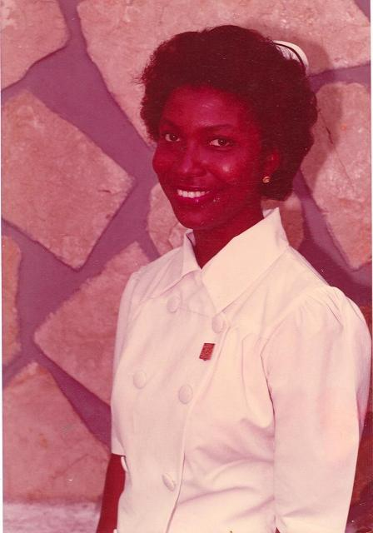
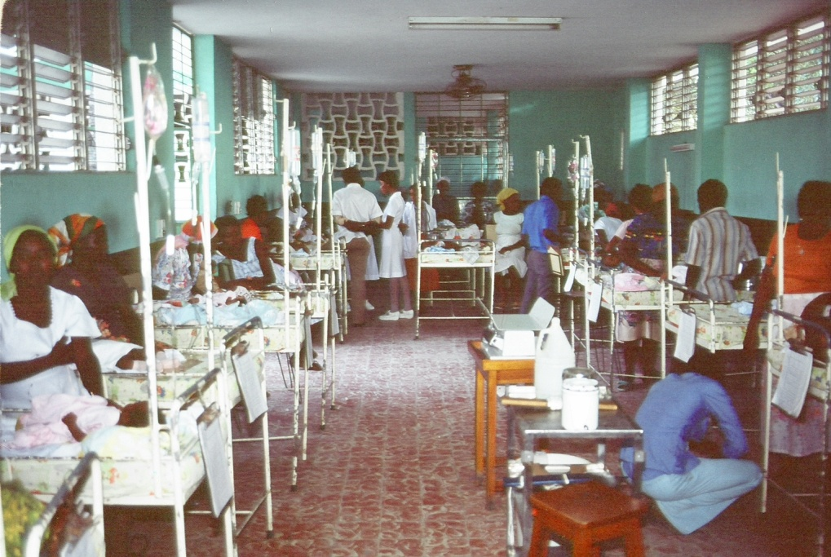
1979: Research, training and care team on infantile diarrhea at the State University Hospital (1979)
Marie Beaulieu MT, Head lab, 1979-2019
Jean W Pape MD, Director, 1979-2019
Yonie Cadot, Head Nurse, 1979-2019
High mortality rate for infantile diarrhea: >40% that decreased to <1.0%
Better clinical management of patients
Introduction of oral rehydration therapy (ORT)

Slide 6
1979-2000: Impact on infantile mortality in Haiti
Mortality Rate HUEH
1965-2000
National Infantile Mortality 1980-2008
September 1979: start of interventions
1982: National program to control infantile diarrhea with our Unit as national training center: we trained >14,000 health workers and > 155,000 parents

Slide 7
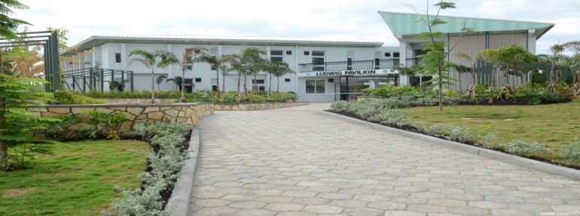
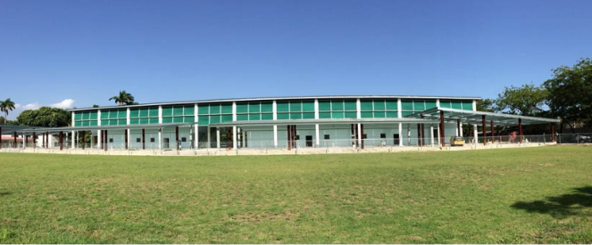
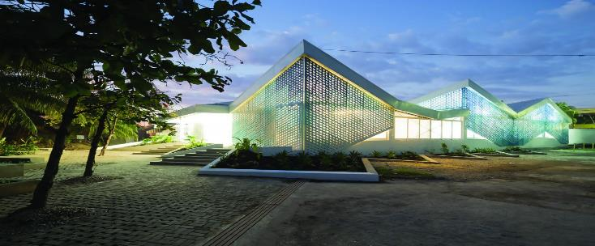
Les Centres GHESKIO (May 2, 1982)
AIDS, TB Comprehensive Center for:
  Translational research aimed at developing public health models
  Training: largest post graduate training center in Haiti
  Services: one of the largest AIDS and TB centers in the Americas
Extended to diarrheal diseases, malaria, dengue, HPV, nutrition, chronic diseases
Post-earthquake: global health aimed at the poor: care for IDP, primary, vocational, education and microcredit programs
Partnership: Ministry of Health and 116 local institutions
Foundation created by private sector to support GHESKIO (1993)
Granted of “Utilité Publique” by Haitian government (2000)
Strong international collaboration: Cornell, Fondation Mérieux…
Continuous support from NIH (1983), Fogarty (1988)

Slide 8
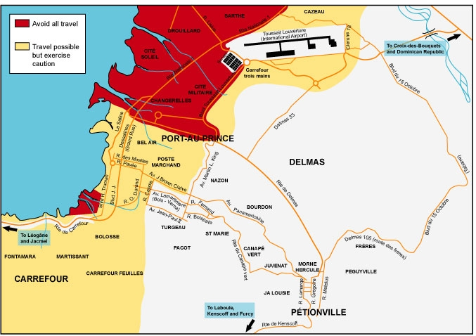
United Nations Travel Advisory Map for Port-au-Prince
GHESKIO
GHESKIO

Slide 9
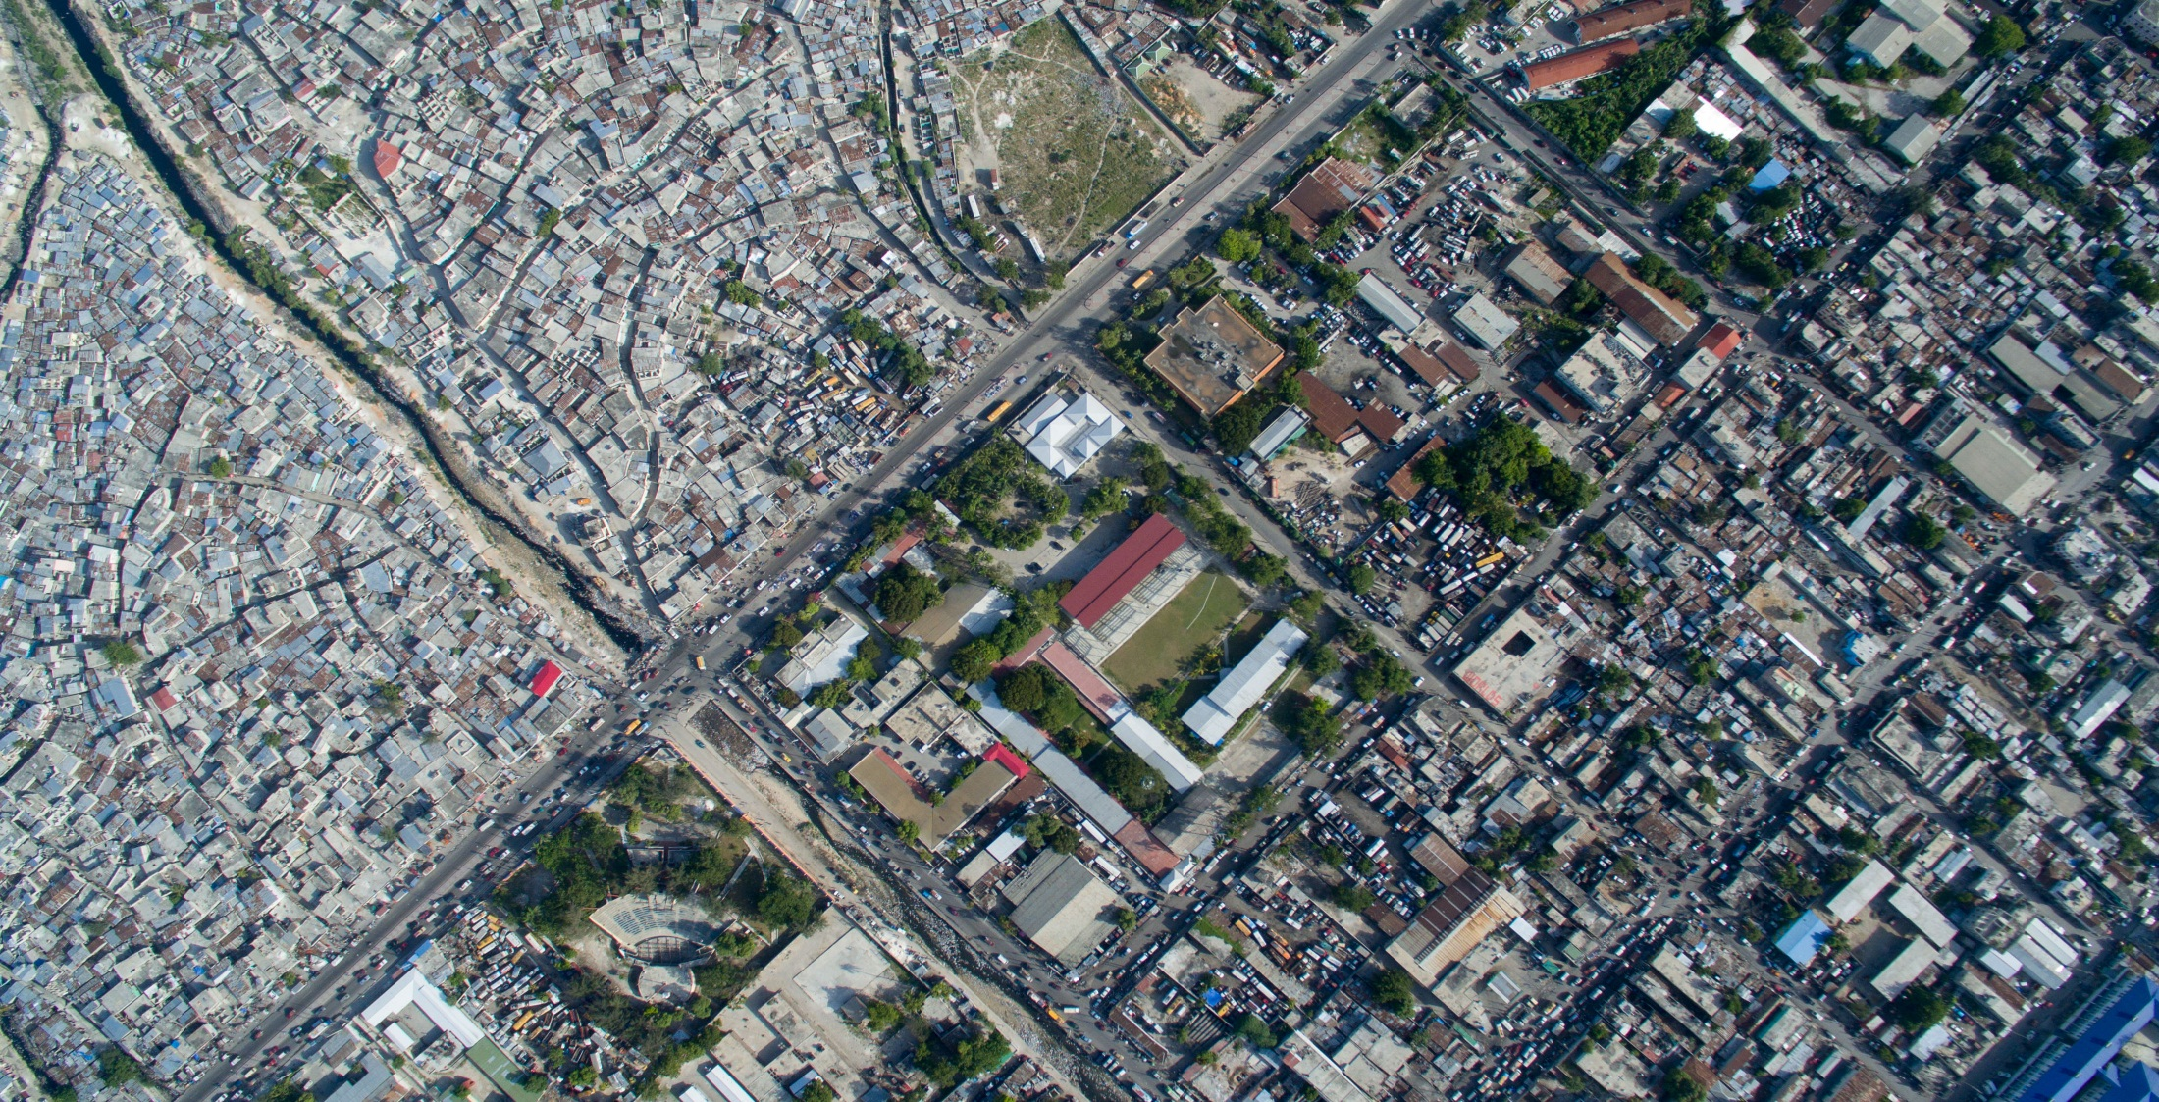
Les Centres GHESKIO-INLR
Slums of City of God
“Kosovo”
Aerial view of GHESKIO Centers in downtown
Port-au-Prince

Slide 10
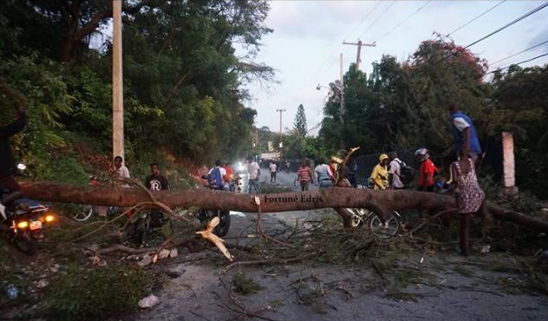
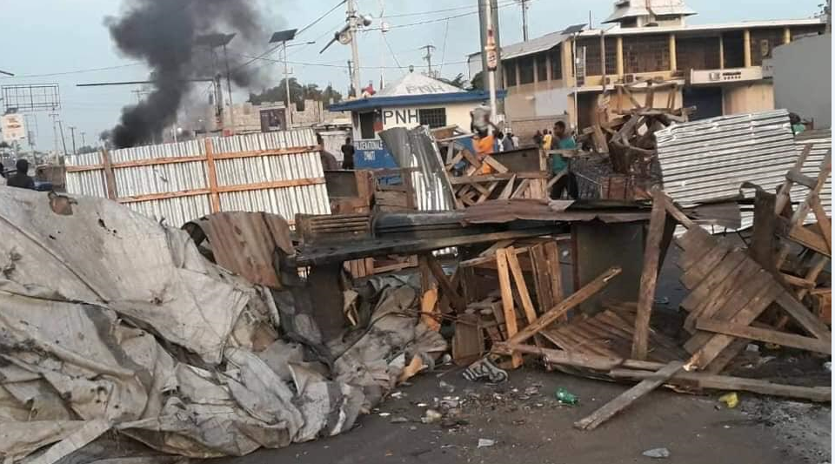
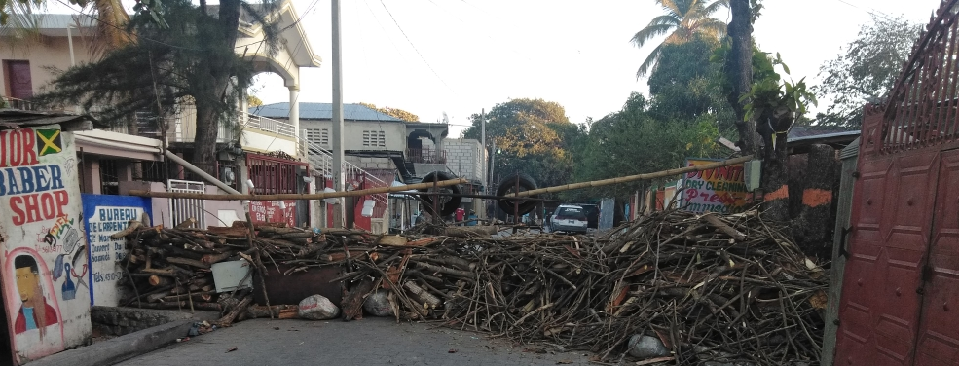
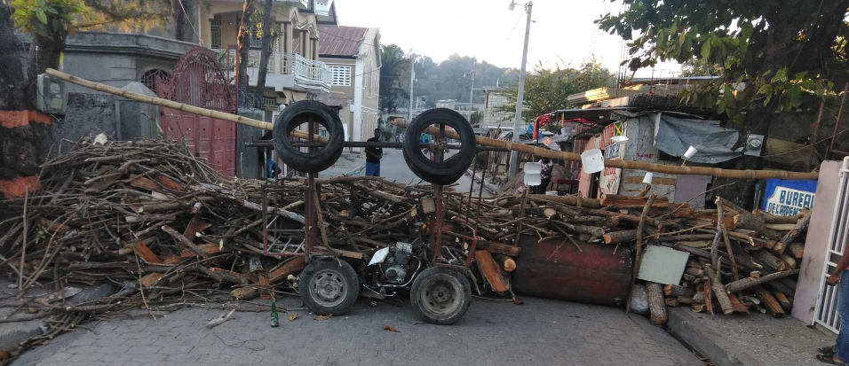
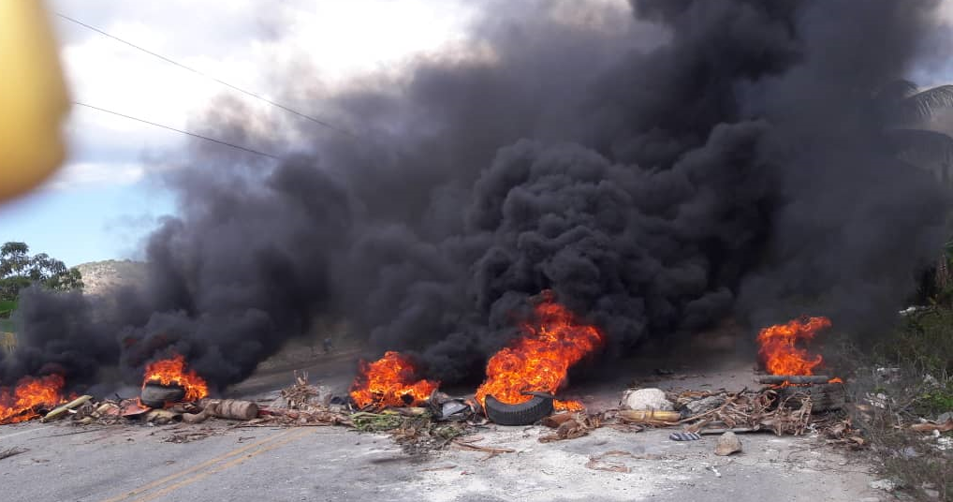
Protests barricades
October 2018 and November 2019

Slide 11
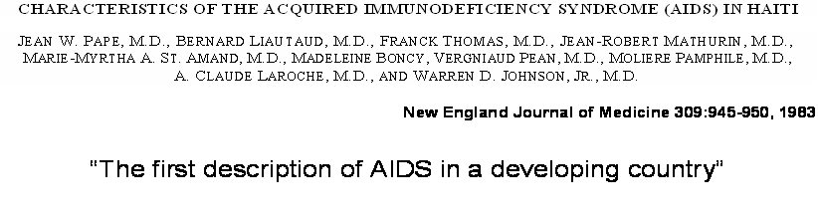
Characteristics of Tropical AIDS
Chronic diarrhea (coccidia)
Cutaneous manifestations : Kaposi sarcoma, Prurigo
Pulmonary manifestations: >50% TB
Male Predominance (89%)
Pape et al, NEJM 309:945-950,1983

Slide 12
GHESKIO challenges:1982-2019*
1982-1990: Defining AIDS
  Modes of transmission ? Opportunistic infections
1991-2002: Can AIDS be controlled ?
  Creation of a public model of prevention and care
2003: national extension of the model
2010- 2012: hurricanes, earthquake, cholera…
  Development of a global health model
2012-2019
  Development of a model for the care of MDRTB
  Epidemics of chikungunya, zika, chronic diseases
*Constant environmental, social , political problems all along this period

Slide 13

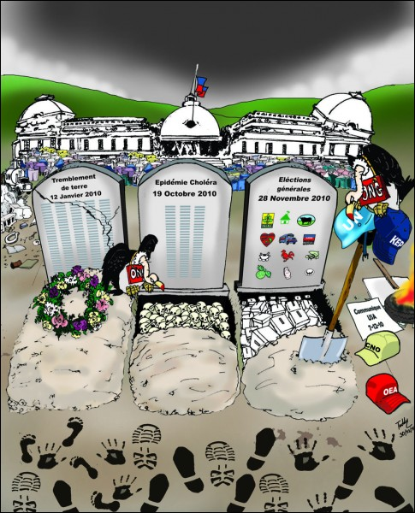
31 décembre 2010
A review of The year 2010: catastrophic
Earthquake: 316,000 deaths
Cholera: 3,300 deaths
Elections ??????????

Slide 14
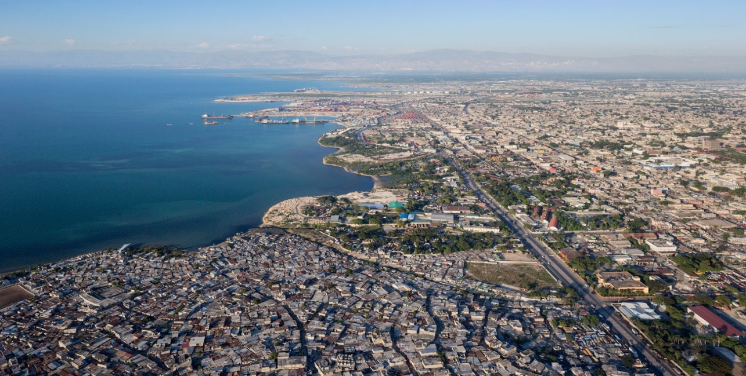
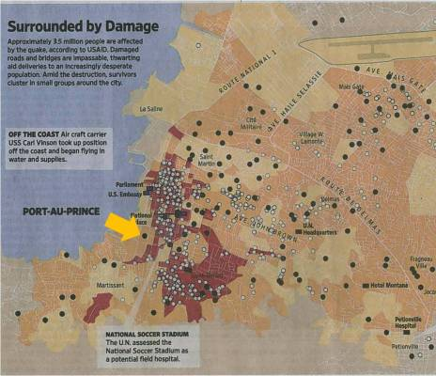
Bay of Port au Prince, Haiti
GHESKIO
GHESKIO
GHESKIO
Red areas most affected in the center of Port-au-Prince.. Blue arrow shows the location of GHESKIO. Courtesy of the Wall Street Journal

Slide 15
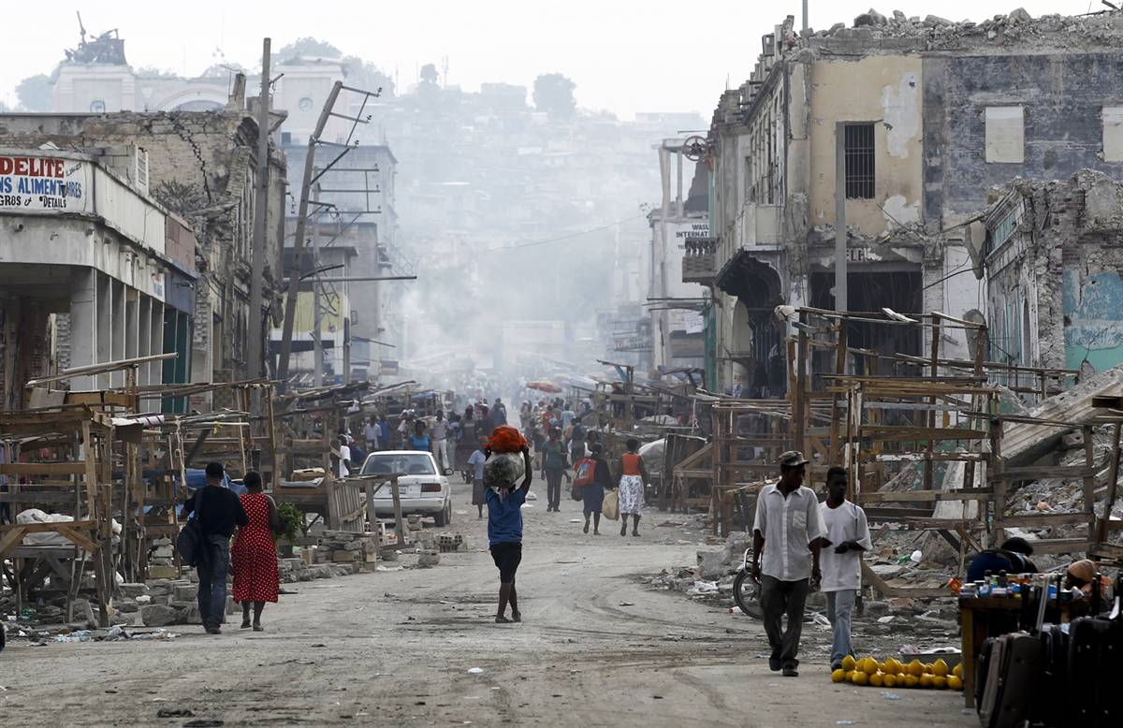
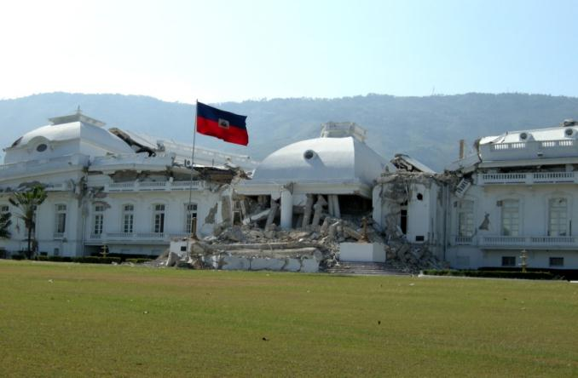
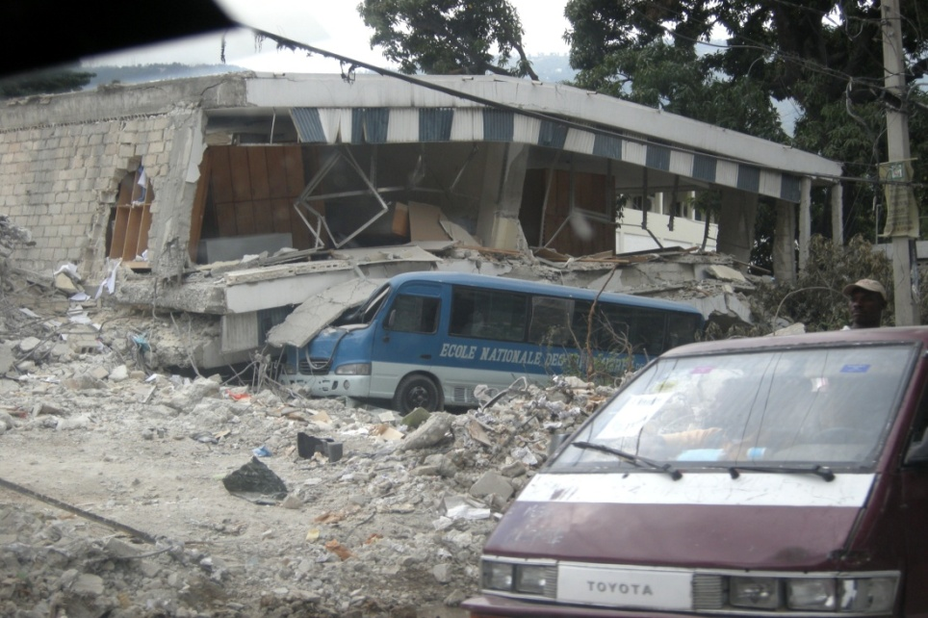
January 12, 2010, 4:53pm Earthquake Toll
GHESKIO
4 Staff members dead, 70 lost 1 or more family members
75% of GHESKIO buildings severely damaged or destroyed
Port-au-Prince Area
> 300,000 dead, 240,000 injured
Most government facilities destroyed
1.5 million homeless in tents
Boulevard La Saline - Main Commercial Center
Presidential Palace
Nursing School

Slide 16
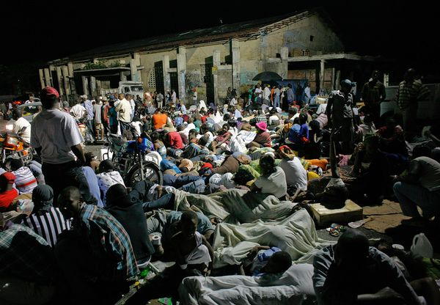
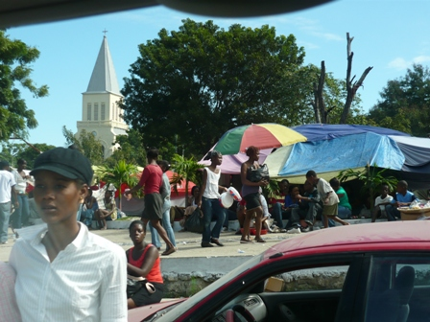
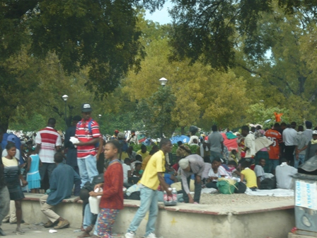
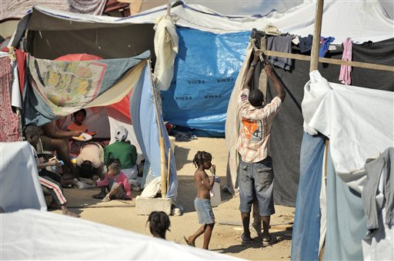
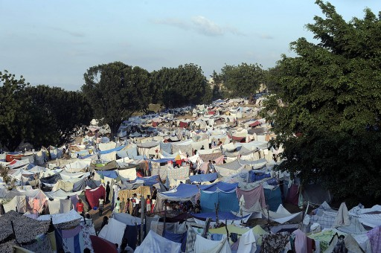
“Tent cities”
1.5 million displaced persons

Slide 17
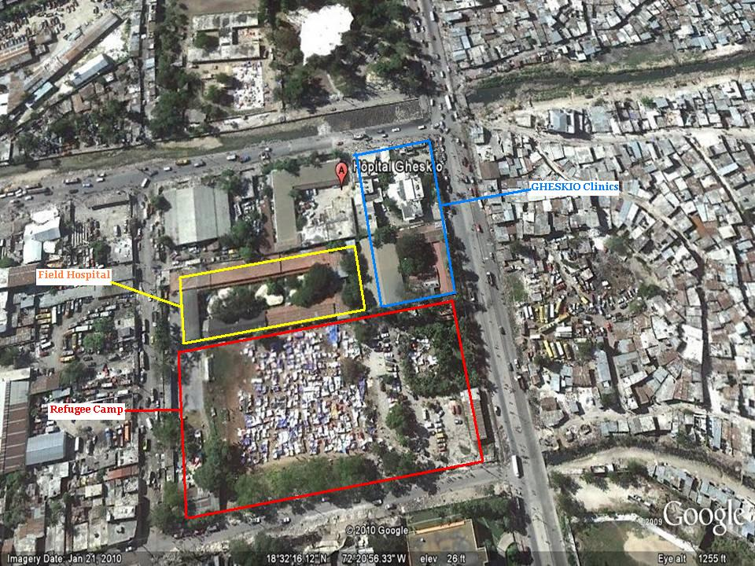
GHESKIO refugee camp, field hospital, and clinics
>10,000 refugees: 75% women and children

Slide 18
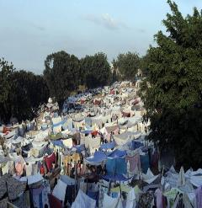
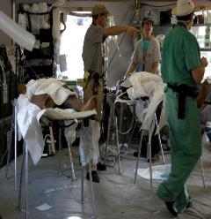
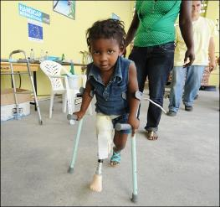
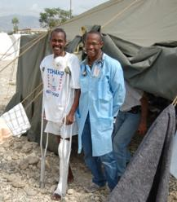
GHESKIO Post Earthquake Challenges
GHESKIO responded by fulfilling its mission: services, training and research on HIV/AIDS.
+ 4 new tasks:
  Establish an acute care hospital for severely injured
  Establish a field hospital for TB patients
  Provide TB diagnostics to hospitals/clinics and “tent cities”
  Global Health services to internally displaced persons.
Pape JW et al N Engl J Med. 2010 10 (1056) 1-3; Pape JW et al N Engl J Med. 2010 10 (1056) 1-2;

Slide 19
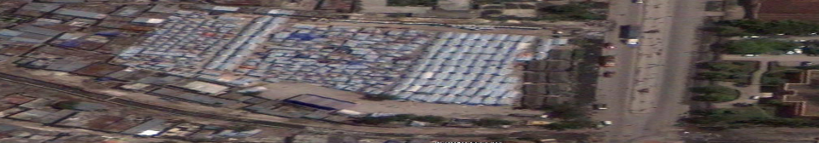
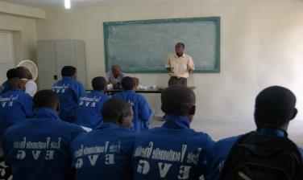
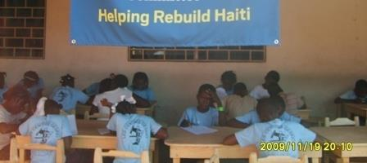
Global Health Program for IDP at GHESKIO
Available potable water from day 1
Set-up Committee to run the daily activities at the camp
Daily evaluation of patients with fever, cough, diarrhea and rash
Immunization of children and women, prenatal care
Prevention of gender violence , and STIs
Microcredit and job creation
Creation of primary and trade schools
Vocational and Primary Schools

Slide 20
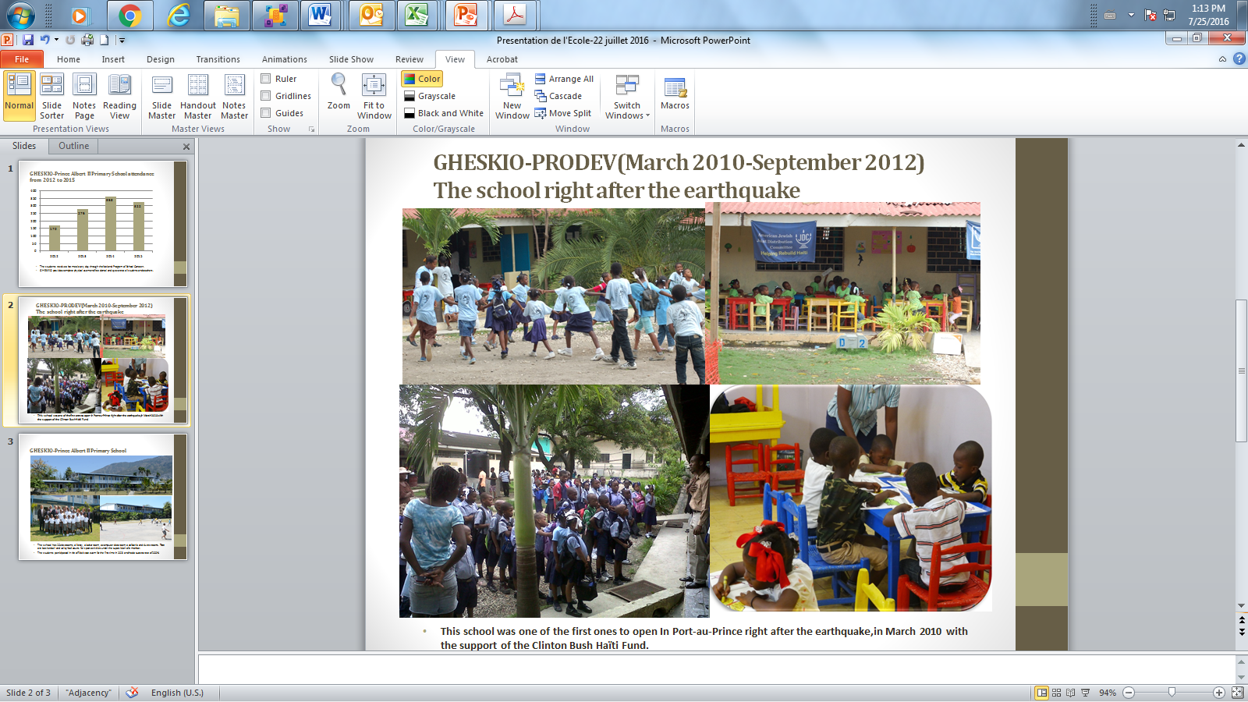

Slide 21

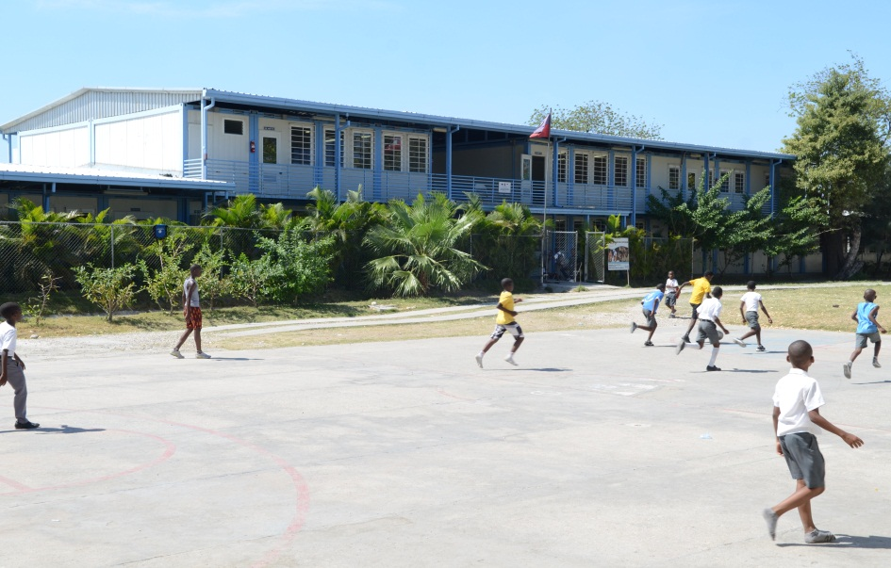
Primary school Prince Albert II de Monaco

Slide 22
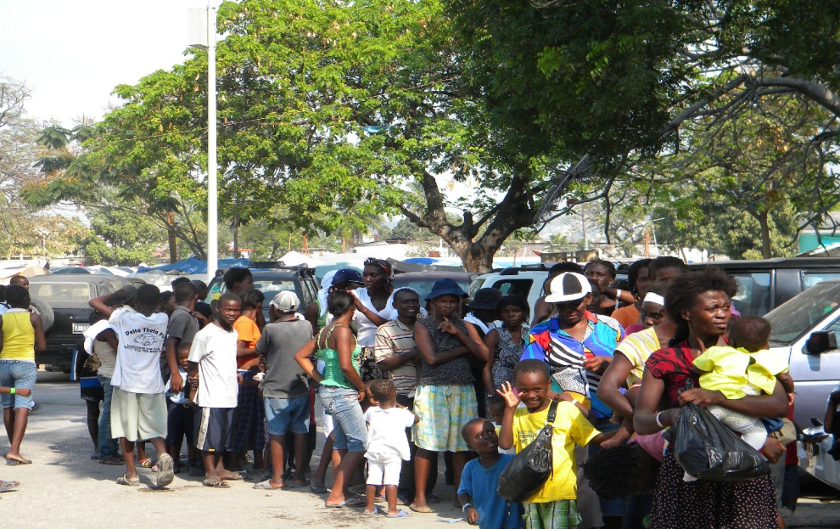
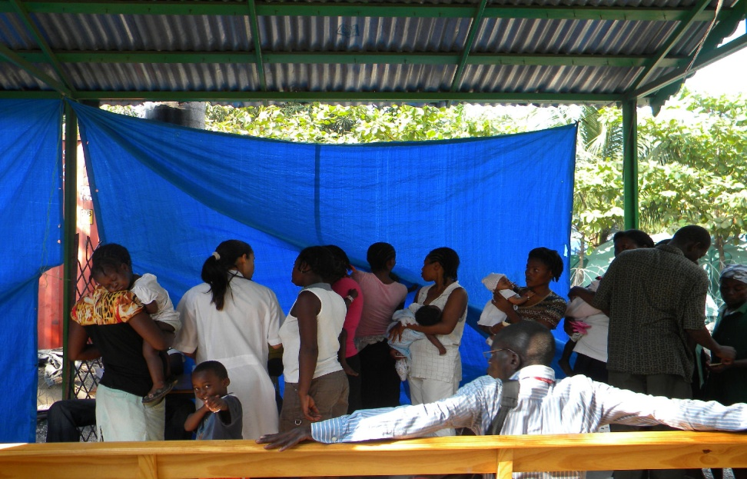
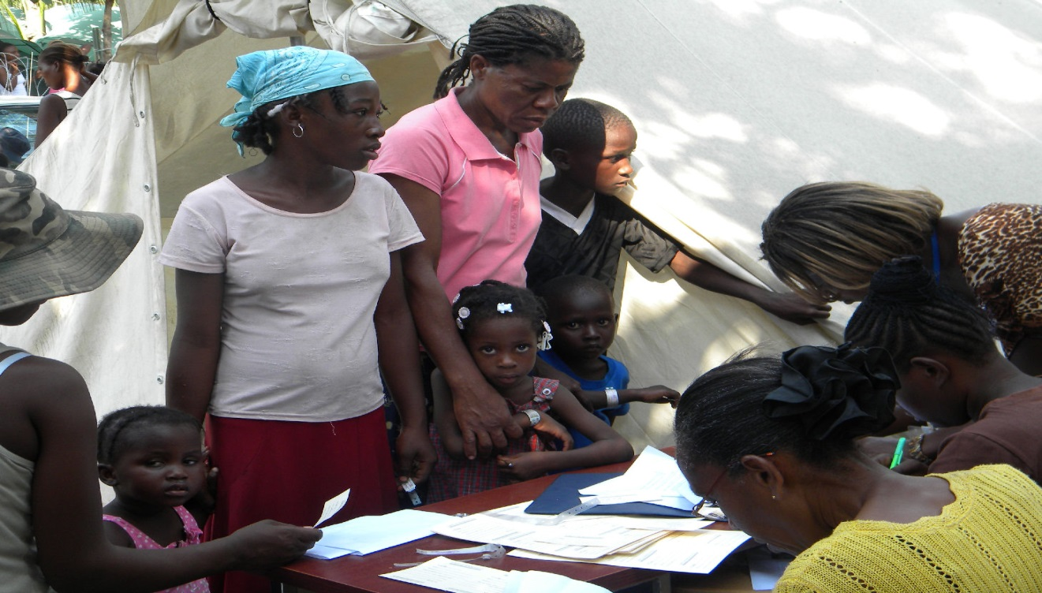
Vaccination of women and children

Slide 23
Volunteers on NIH-research protocols
2010-2011
 | Jan 12, 2010 | Jan 12, 2011
HVTN | 245 (4 trials) 5 deaths due to quake | 359* (4 trials)
ACTG | 177 (4 trials) 8 deaths due to quake | 334* (5 trials): 2 completed
CIPRA | 737 10 deaths due to quake | 727
IMPAACT | Not yet open | SIP approved
TOTAL | 1,159: 18 deaths due to quake | 1,400

Slide 24
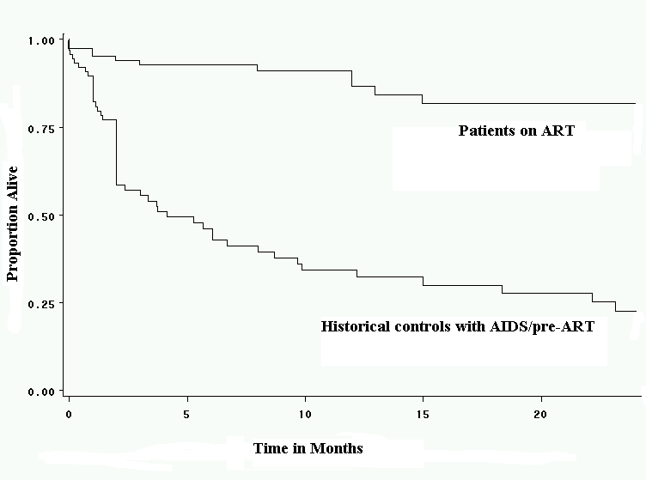
Antiretroviral Therapy and Survival in adults
1 year survival: 90%
5 years survival:75%
Leger P et al NEJM 2009;361:828-829
90% dead at 1 year
10 year survival : 70%
Severe P et al NEJM 2005 353:22-2325-2334
Pierre S, et al. NEJM 2016; 374:397-398

Slide 25
HAART national scale-up
GHESKIO-MOH network
30% of all patients on ART in HAITI
HIV prevalence in Haiti

Slide 26
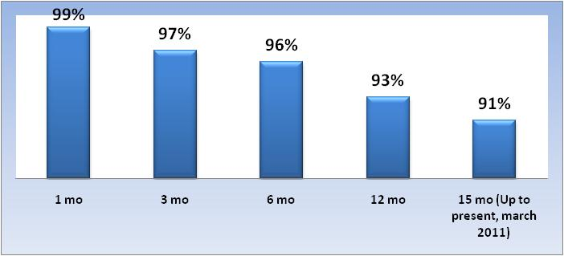
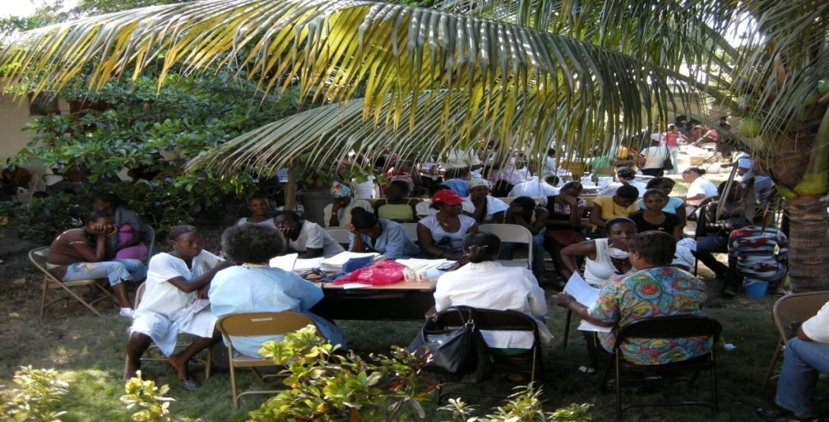
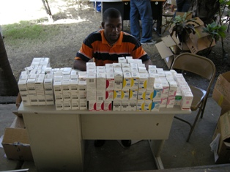
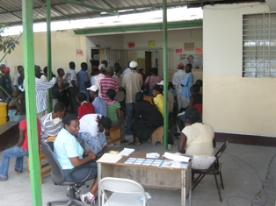
Patients actively followed on ART before and after earthquake
Retention in care post earthquake
Outdoor Clinic
Outdoor Pharmacy

Slide 27
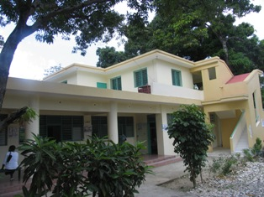
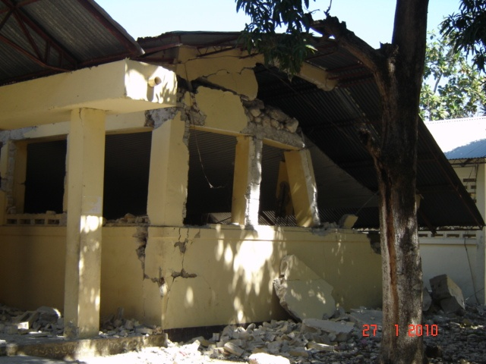
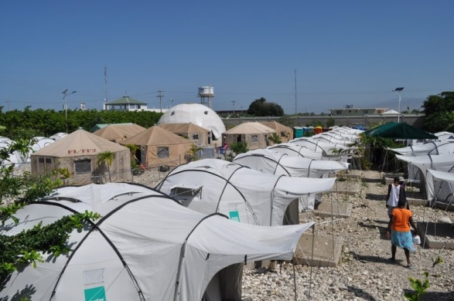
GHESKIO MDRTB/ HIV/TB Hospital
before and after quake
The GHESKIO TB hospital housed 80 patients including 23 with MDRTB. 5 patients died

Slide 28
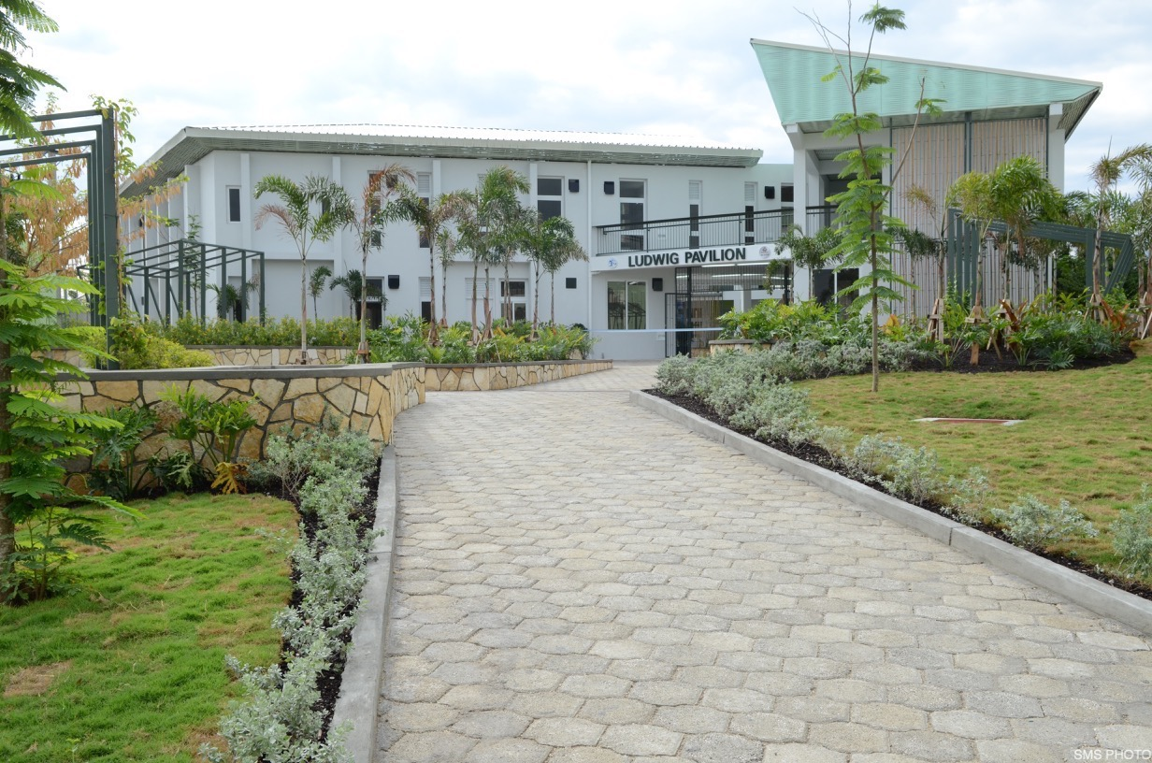
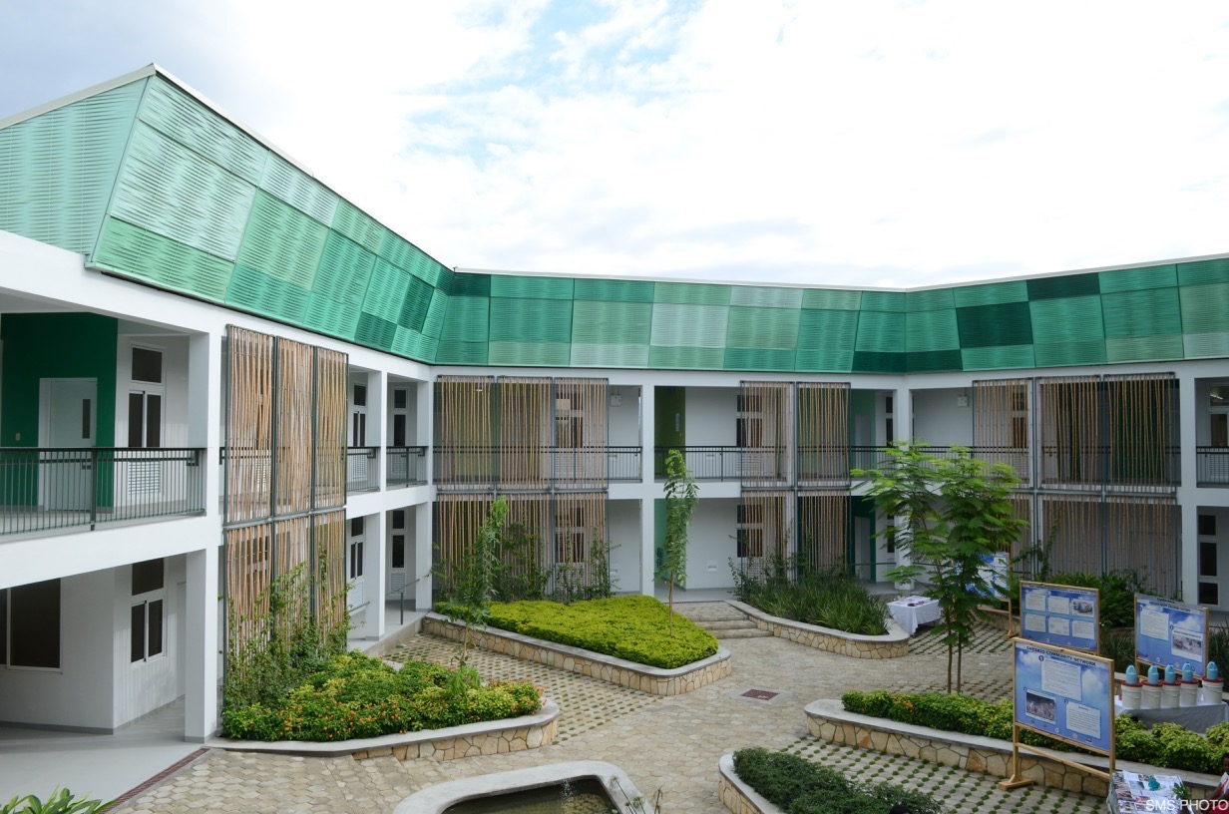
MDRTB Ludwig Pavilion

Slide 29
GHESKIO TB CASES 2009-2018
336% increase in children
Koenig S, et al Tuberculosis in the aftermath of the 2010 earthquake in Haiti. Bulletin of WHO , 2015

Slide 30
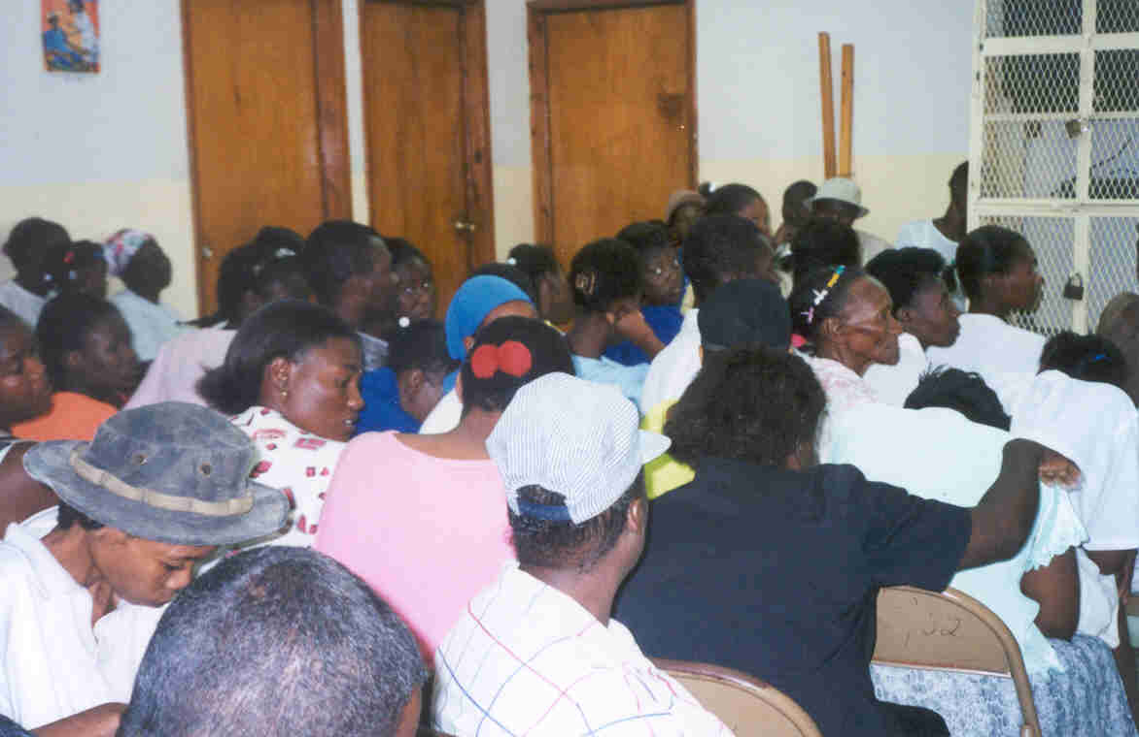
Early TB diagnosis at Voluntary Counseling and Testing Center (VCT) 2001-2007
YEAR | N Screened for HIV | N with Cough | N with TB
2001 | 9,743 | 1,251 | 294
2002 | 12,110 | 1,573 | 394
2003 | 15,808 | 2,003 | 509
2004 | 17,411 | 1,672 | 625
2005 | 17,482 | 1,544 | 502
2006 | 16,611 | 1,416 | 562
2007 | 17,999 | 2,303 | 637
TOTAL | 107,164 | 11,762 | 3,523
30% of all with cough >2 weeks have active TB
HIV testing services attract many persons specially TB patients.
Unique opportunity to intervene in TB prevention and care: Patients with cough suspected of TB can be rapidly identified, removed from the crowded waiting room and screened the same day for active TB:
  HIV+ patients without active TB can be placed on IPT the same day
  HIV+/HIV-patients with active TB are placed on same day treatment to prevent ongoing transmission since 2002.
Burgess et al. AIDS 2001

Slide 31
Active Case Finding for TB in Slums in Haiti
104,127 individuals were contacted for cough
7,072 reported cough >2 weeks and
were referred to GHESKIO
5,598 were evaluated for TB
1,110 were diagnosed with TB= 20% of all evaluated (16 RIF-resistant/MDR TB cases))
Detected a TB prevalence of 1066/100,000: >4 X national estimate
8% HIV prevalence: 4 X national estimate
Rivera VR et al The International Journal of Tuberculosis and Lung Disease, (21); 11; 1140-1146; 1 November 2017
Notes:
From August 1, 2014 to July 31, 2015, 104,127 residents were queried about participation in the ACF campaign, and 104,097 agreed to provide information, and were screened for chronic cough. Of these, 7072 (7%) reported chronic cough and were referred to GHESKIO, and 5598 (5%) satisfied the study inclusion criteria and were included in the analyses (Figure 2). Of the 1474 patients who were not included in the analyses, 146 never presented to GHESKIO for evaluation, 793 were <10 years of age, 436 did not have cough at the time of physician evaluation, and 99 were lost to care prior to receiving TB testing. Among the 5598 patients included in the analyses, the median age was 31 (interquartile range [IQR]: 22 to 46), 3366 (60%) were female, and 3079 (55%) had no school or primary school only (Table 2). HIV testing was completed for 5472 (98%) patients, and 528 (10%) were HIV-positive. Median CD4 count was 311 cells/mm³ (IQR: 128 to 503).
Questions/Discussion:
**Explain discordance: implementation uptake—CHW training to increase screening sensitivity and chronic cough detection; also self-report in community may incentivize patients to over-report for free care and services at GHESKIO….comparing community cough data to clinic data in Aug 2014, physicians were confirming cough 37% of referred TB suspects; by July 2015, over 60% of TB suspects were confirmed with cough.

Slide 32





GHESKIO Response to 2010 Cholera epidemic
1. Cholera Treatment Centers (CTC) ORPs
2. Chlorine factory
3. Introduction of oral cholera vaccine
Changed WHO guidelines

Slide 33
Two most critical issues in AIDS care
Linkage to care
Retention in care

Slide 34

Standard vs. Same-day ART
NOW test and treat included in WHO guidelines
Koenig S,et al PLoS Med. 2017 Jul 25;14(7):e1002357.
Notes:
Need to change initiated ART to 92% for standard group; need to change alive and in care to 71% for standard and 80% for same-day; need to change alive with undetectable VL to 50% for standard and 61% for same-day.

Slide 35
Retention in Care is complex
Majority of new patients are well!
Nutritional support
  CROI 2018, Boston, March 4-7
Decrease time in clinics
  Guiteau C et al JAIDS 2018 Sept 1;79(1)
Transportation support
Frequent reminders phone calls

Slide 36
Provision of HIV care at times of crisis
Need to develop a contingency plan
  adapted to the context ,
  reviewed and improved after each challenge
Strong community support and collaboration
  Collaboration with local institutions
  Community advisory board (CAB)

Slide 37
Community Advisory Board
Bridge between our institution and the community
Constituted by 27different sectors of society
Women associations
  FAM VAYAN: against gender based violence
  TANDEM: about issues of importance for women
  Youth: STRONG : aims at changing risky behaviors
MSM: 3 associations: kourag-Serovie-Arc-en-Ciel
Religious : 4 religions represented (vodou, catholic, protestant , Adventist)
Education: 3 parents organizations
Community leaders from the 5 slums around GHESKIO
Volunteers from the community in 3 slums

Slide 38
Preparatory phase of Contingency plan
Plan for level of urgency and establish measures to counter
Review call chain (list and phone number of heads of services; teams in each unit)
Review pharmacy plan: enough meds ARV, TB; points of distribution
Review the role of community health agents
Power supply: insure enough fuel for power generators, inverters , batteries, UPS all functioning, flash lights, water pump functioning, water supply
Establish 3 multidisciplinary staff teams at each center and how to reach each point of services: availability of cars, fuel, drivers;
Plan to provide food, water to hospitalized patients and key staff on sites
Secure major equipment; consider transfer in more secured areas
Availability of cash funds for quick response to unforeseen situations

Slide 39
Activate contingency plan by urgency Level
        Examples Institution
Level Yellow
(low level) Public transport strike Full capacity
Level Orange Violent street march Reduced (medium)
Severe hurricane
Level Red Streets with barricades, Closed
(Very serious) Violent crowds Opened for essential services major earthquake with reduced staff

Slide 40
Policy for medications
Key medications available at all times in stock/urgent units
  Inventory done daily in units and weekly in stock
  Extra (up to 6 months) medications provided to stable patients (suppressed VL)
  Medications available at key distribution points
Patients have access to the urgent units where key meds are available at all times (rape victims, AES, HIV and TB units)
When patients cannot come to sites to get their meds:
  They go to key distribution points to get them or
  Community health agents go to their home

Slide 41
How to reach patients at times of crisis ?
Establish 24 hours phone lines
Phone calls
  Call Patients
  Call Correspondent
Home visits
Radio/TB messages and provide 2 hot lines to call
Through other patients/HIV+ associations

Slide 42
Retention in care during crisis
  Extra medication (2 weeks) to patients to weather the crisis
  Depend on degree of crisis, access or no access to care centers
    If access possible, and or level of threat reasonable :
      Multidisciplinary team on rotation to provide services
      Establish rotation schedule
    If access not possible and level of threat high
      Stock of drugs outside medical centers at key locations
  24 hour hotline to give info to patients
  Stock of fuel for 4 weeks at our 2 centers

Slide 43
Summary
In Haiti despite political unrests, natural disasters, possible to provide effective HIV care.
Institution must have a great track records in absence of crisis with impeccable ethics; deeply rooted in the community it serves and with a dedicated and experienced staff
At times of crisis : must have in place a contingency plan
  Planning ahead of time is key (macro and micro)
    Mobilize key staff;
    Medications: give more to have time to catch up
    Lab reagents
    Fuel for vehicles and power generators
    Security
    Food/water for hospitalized patients and staff
    How to reach patients in different situations?
The contingency plan must be tested, updated and improved after each new challenge

